Slide 1

FLUTTER
FLUTTER #5

Slide 2

FLUTTER
PROJETO HELLO WORLD

Slide 3

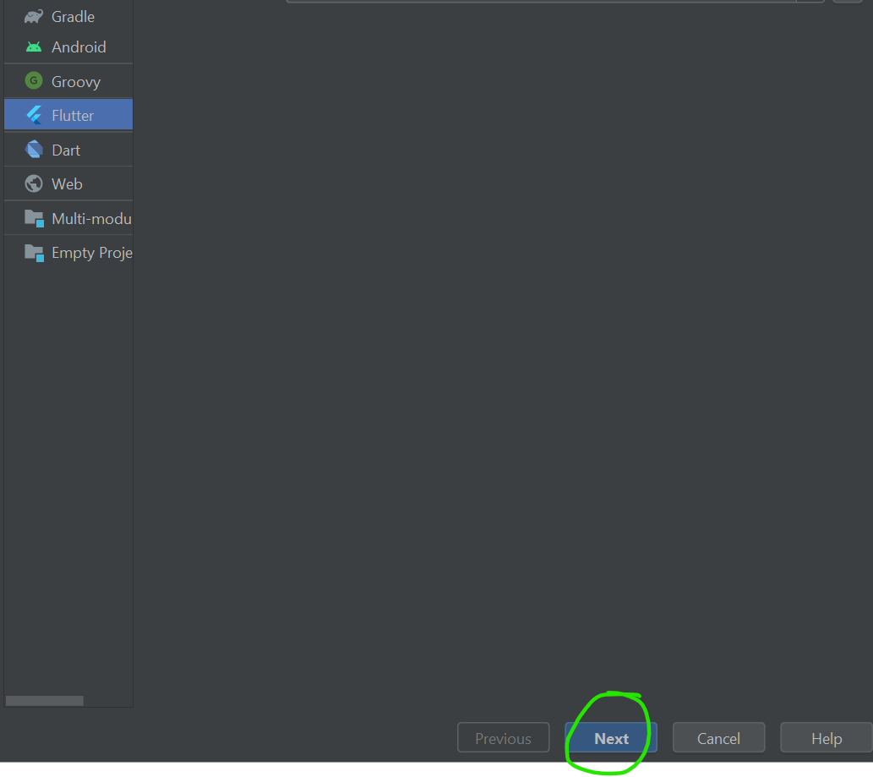
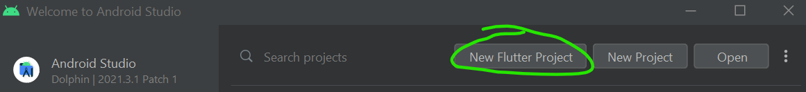
FLUTTER
Executando no browser.
Abra o Android Studio.
Selecione New Flutter project.
Especifique o SDK

Slide 4

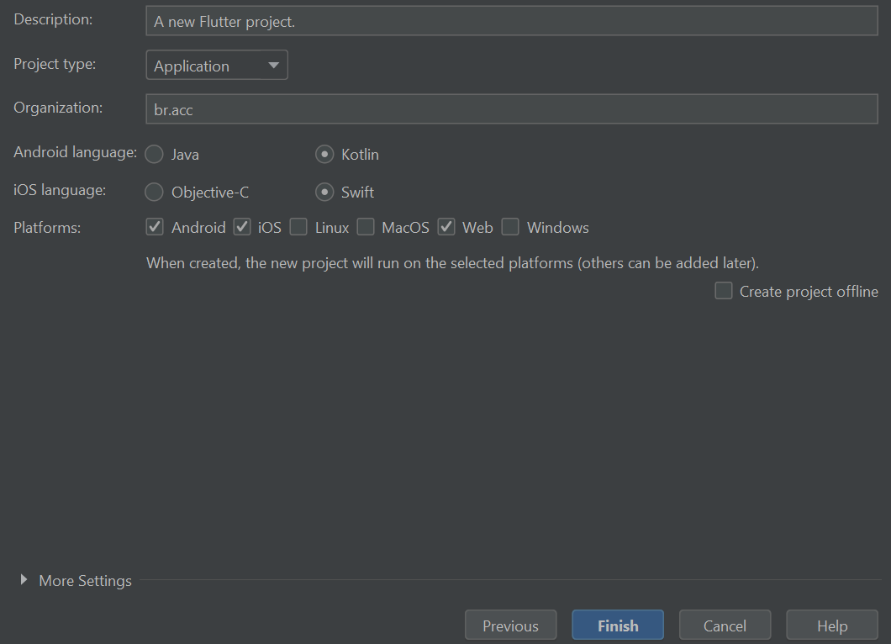
FLUTTER
Name: HelloWorld.

Slide 5
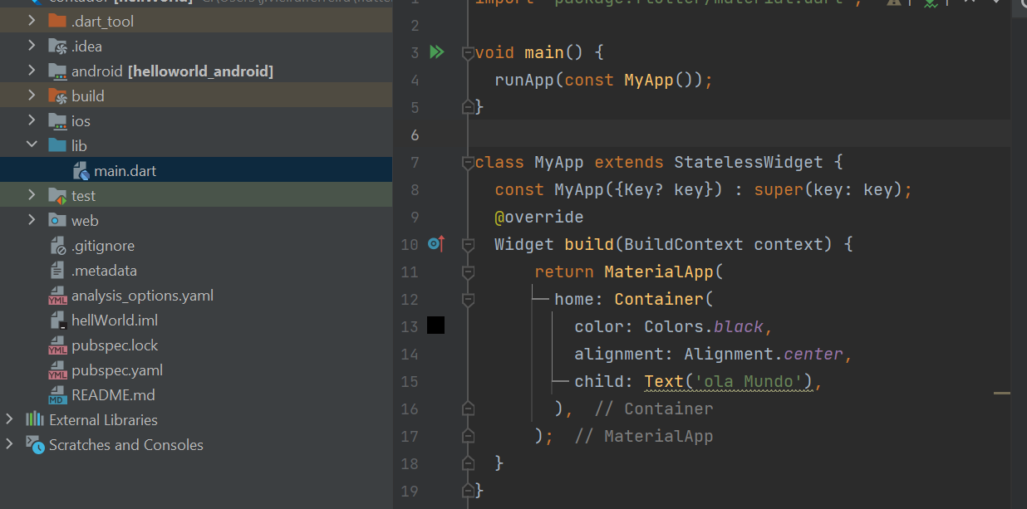
FLUTTER
Abra o main.dart.
Sobreponha seu conteúdo pelo deste slide.
Notes:
import 'package:flutter/material.dart';
void main() {
runApp(const MyApp());
}
class MyApp extends StatelessWidget {
const MyApp({Key? key}) : super(key: key);
@override
Widget build(BuildContext context) {
return MaterialApp(
home: Container(
color: Colors.black,
alignment: Alignment.center,
child: Text('ola Mundo')
),
);
}
}

Slide 6
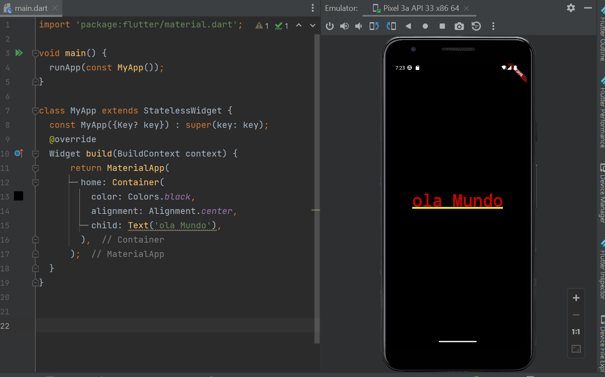
FLUTTER
Execute o App.

Slide 7
FLUTTER
Melhorando o Projeto

Slide 8
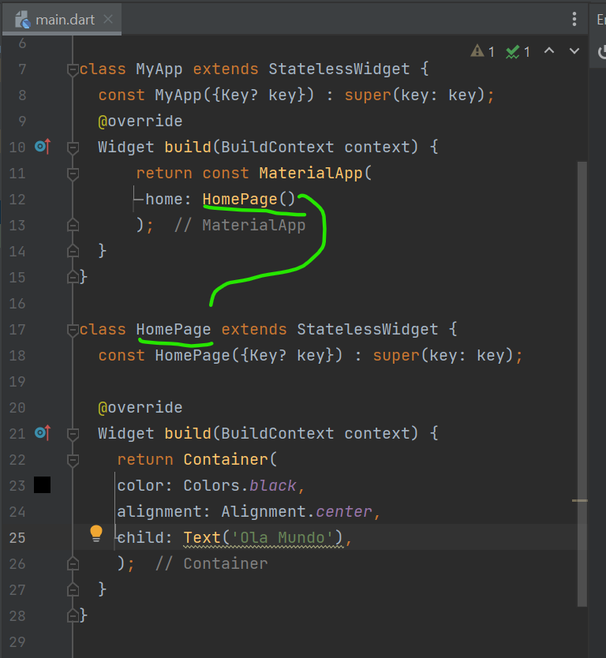
FLUTTER
Acrescente mais um widget, a HomePage.
Execute o App.
Notes:
import 'package:flutter/material.dart';
void main() {
runApp(const MyApp());
}
class MyApp extends StatelessWidget {
const MyApp({Key? key}) : super(key: key);
@override
Widget build(BuildContext context) {
return const MaterialApp(
home: HomePage()
);
}
}
class HomePage extends StatelessWidget {
const HomePage({Key? key}) : super(key: key);
@override
Widget build(BuildContext context) {
return Container(
color: Colors.black,
alignment: Alignment.center,
child: Text('Ola Mundo'),
);
}
}

